Slide 1
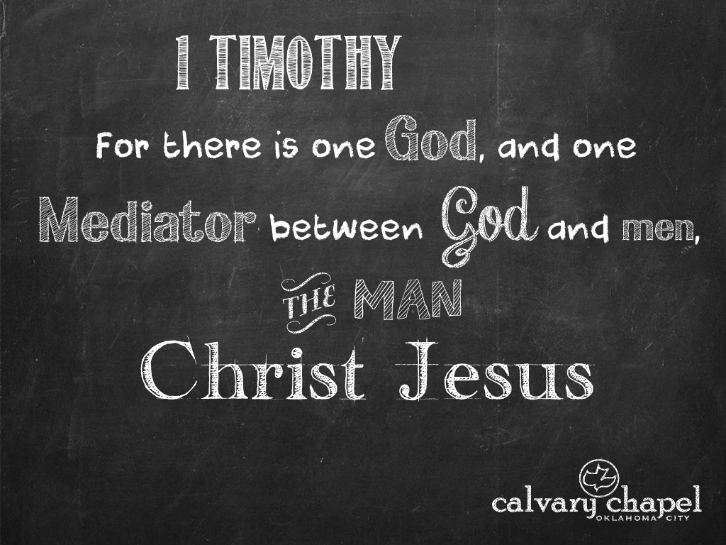
1:1-11

Slide 2

1:1-11
1 Timothy 4:12–5:16 ~ ¹² Let no one despise your youth, but be an example to the believers in word, in conduct, in love, in spirit, in faith, in purity. ¹³ Till I come, give attention to reading, to exhortation, to doctrine. ¹⁴ Do not neglect the gift that is in you, which was given to you by prophecy with the laying on of the hands of the eldership. ¹⁵ Meditate on these things; give yourself entirely to them, that your progress may be evident to all. ¹⁶ Take heed to yourself and to the doctrine. Continue in them, for in doing this you will save both yourself and those who hear you.

Slide 3
1:1-11
1 Timothy 4:12–5:16 ~ ^{5:1} Do not rebuke an older man, but exhort him as a father, younger men as brothers, ² older women as mothers, younger women as sisters, with all purity.
³ Honor widows who are really widows. ⁴ But if any widow has children or grandchildren, let them first learn to show piety at home and to repay their parents; for this is good and acceptable before God. ⁵ Now she who is really a widow, and left alone, trusts in God and continues in supplications and prayers night and day. ⁶ But she who lives in pleasure is dead while she lives. ⁷ And these things command, that they may be blameless.

Slide 4
1:1-11
1 Timothy 4:12–5:16 ~ ⁸ But if anyone does not provide for his own, ⁹ Do not let a widow under sixty years old be taken into the number, and not unless she has been the wife of one man, ¹⁰ well reported for good works: if she has brought up children, if she has lodged strangers, if she has washed the saints’ feet, if she has relieved the afflicted, if she has diligently followed every good work.
¹¹ But refuse the younger widows; for when they have begun to grow wanton against Christ, they desire to marry, and especially for those of his household, he has denied the faith and is worse than an unbeliever.

Slide 5
1:1-11
1 Timothy 4:12–5:16 ~ ¹² having condemnation because they have cast off their first faith. ¹³ And besides they learn to be idle, wandering about from house to house, and not only idle but also gossips and busybodies, saying things which they ought not. ¹⁴ Therefore I desire that the younger widows marry, bear children, manage the house, give no opportunity to the adversary to speak reproachfully. ¹⁵ For some have already turned aside after Satan. ¹⁶ If any believing man or woman has widows, let them relieve them, and do not let the church be burdened, that it may relieve those who are really widows.

Slide 6
1:1-11

Slide 7



1:1-11
conduct ~ anastrophē – to return again
They’ll know we are Christians by our t-shirts
This Photo by Unknown Author is licensed under CC BY-SA

Slide 8
1:1-11

Slide 9
1:1-11
exhortation ~ paraklēsis –NIV, preaching
doctrine ~ didaskalia –NIV, teaching
do it
hear it
do it right

Slide 10
1:1-11

Slide 11
1:1-11
progress (v. 15) ~ prokopē – literally, to cut before

Slide 12
1:1-11

Slide 13
1:1-11
older man (v. 1) ~ presbuteros
Lev. 19:32 ~ You shall rise before the gray headed and honor the presence of the old men,

Slide 14
1:1-11

Slide 15


1:1-11

Slide 16
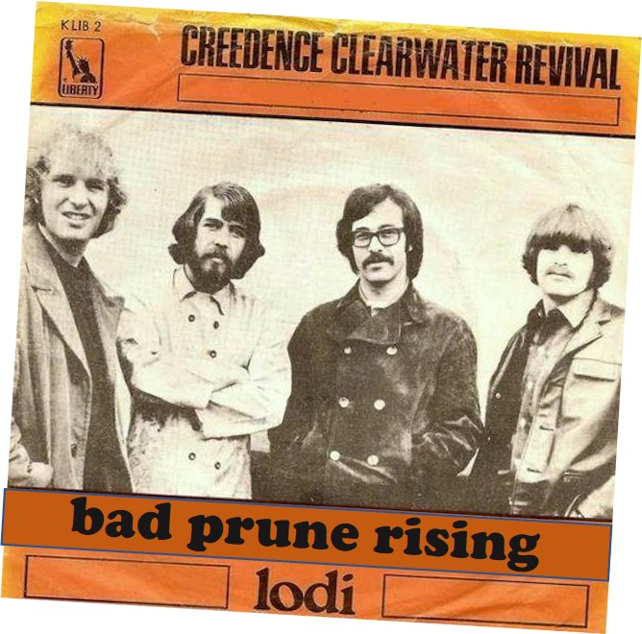

1:1-11

Slide 17


1:1-11

Slide 18


1:1-11

Slide 19


1:1-11

Slide 20


1:1-11

Slide 21

1:1-11

Slide 22

1:1-11

Slide 23
1:1-11

Slide 24
1:1-11
honor ~ timaō
really ~ indeed – KJV, NASB
NIV ~ in need

Slide 25
1:1-11

Slide 26
1:1-11
grandchildren ~ KJV, nephews
Literally, descendants

Slide 27
1:1-11

Slide 28
1:1-11
pleasure ~ spatalaō – verb form of the noun spatalē (luxury)
Literally, pleasuring (seeks her own pleasure and comfort)

Slide 29
1:1-11

Slide 30
1:1-11
wife of one man ~ same criteria as 1 Tim. 2:2; 12

Slide 31
1:1-11

Slide 32
1:1-11
cast off their first faith ~ NIV, have broken their first pledge
Num. 30:2 ~ If a man makes a vow to the Lord, or swears an oath to bind himself by some agreement, he shall not break his word; he shall do according to all that proceeds out of his mouth.
Deut. 23:21 ~ When you make a vow to the Lord your God, you shall not delay to pay it; for the Lord your God will surely require it of
you, and it would be sin to you.

Slide 33
1:1-11

Slide 34
1:1-11
opportunity (v. 14) ~ aphormē – military term meaning base of operations
Satan’s name means adversary, accuser

Slide 35
1:1-11

